Slide 1
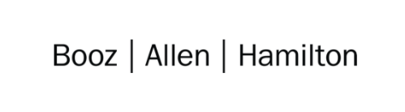

Cloud Technical Excellence Presentation
Team 1
Golden Ducks
Members: Asbury Sellers, Brittany Johnson, Matthew Stevens, Rob Clinger, Zak Sawyer
October 2021
Notes:
Matt
Hello everyone. Welcome to our Tech Excellence presentation! We are Team 1, the Golden Ducks and we've got an awesome application to show you in preparation for the holidays, so grab some popcorn, sit back, and I hope you all enjoy!

Slide 2
TEAM 1: Thanksgiving Madlib Website
Our Official Project for the Booze Allen Cloud Excellence Program
www.webagesolutions.com|1.877.517.6540
Notes:
Mat
For this project, we implemented a Thanksgiving themed Madlib application so that we could create something fun but also create an application which fully integrates with a working production database and a wide variety of AWS services.

Slide 3
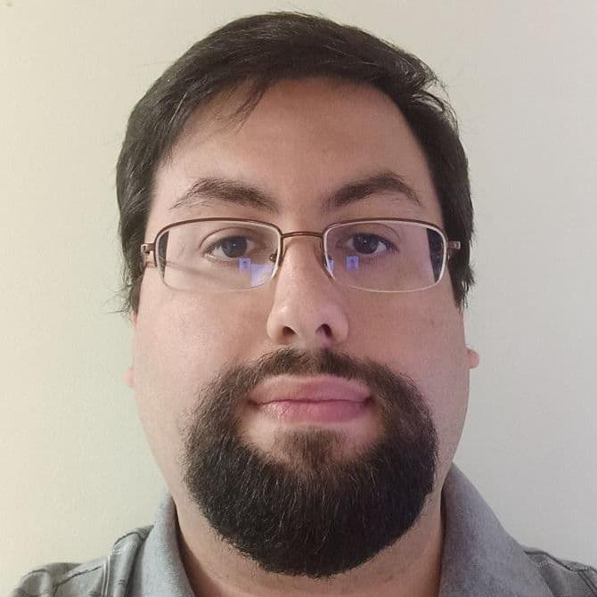
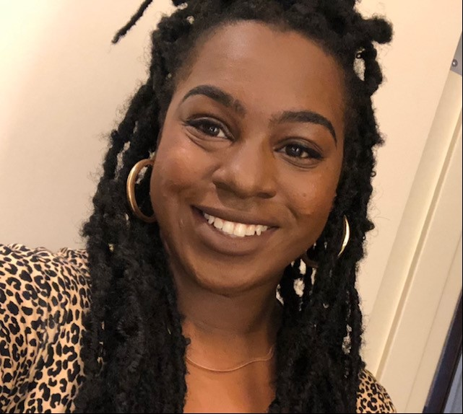
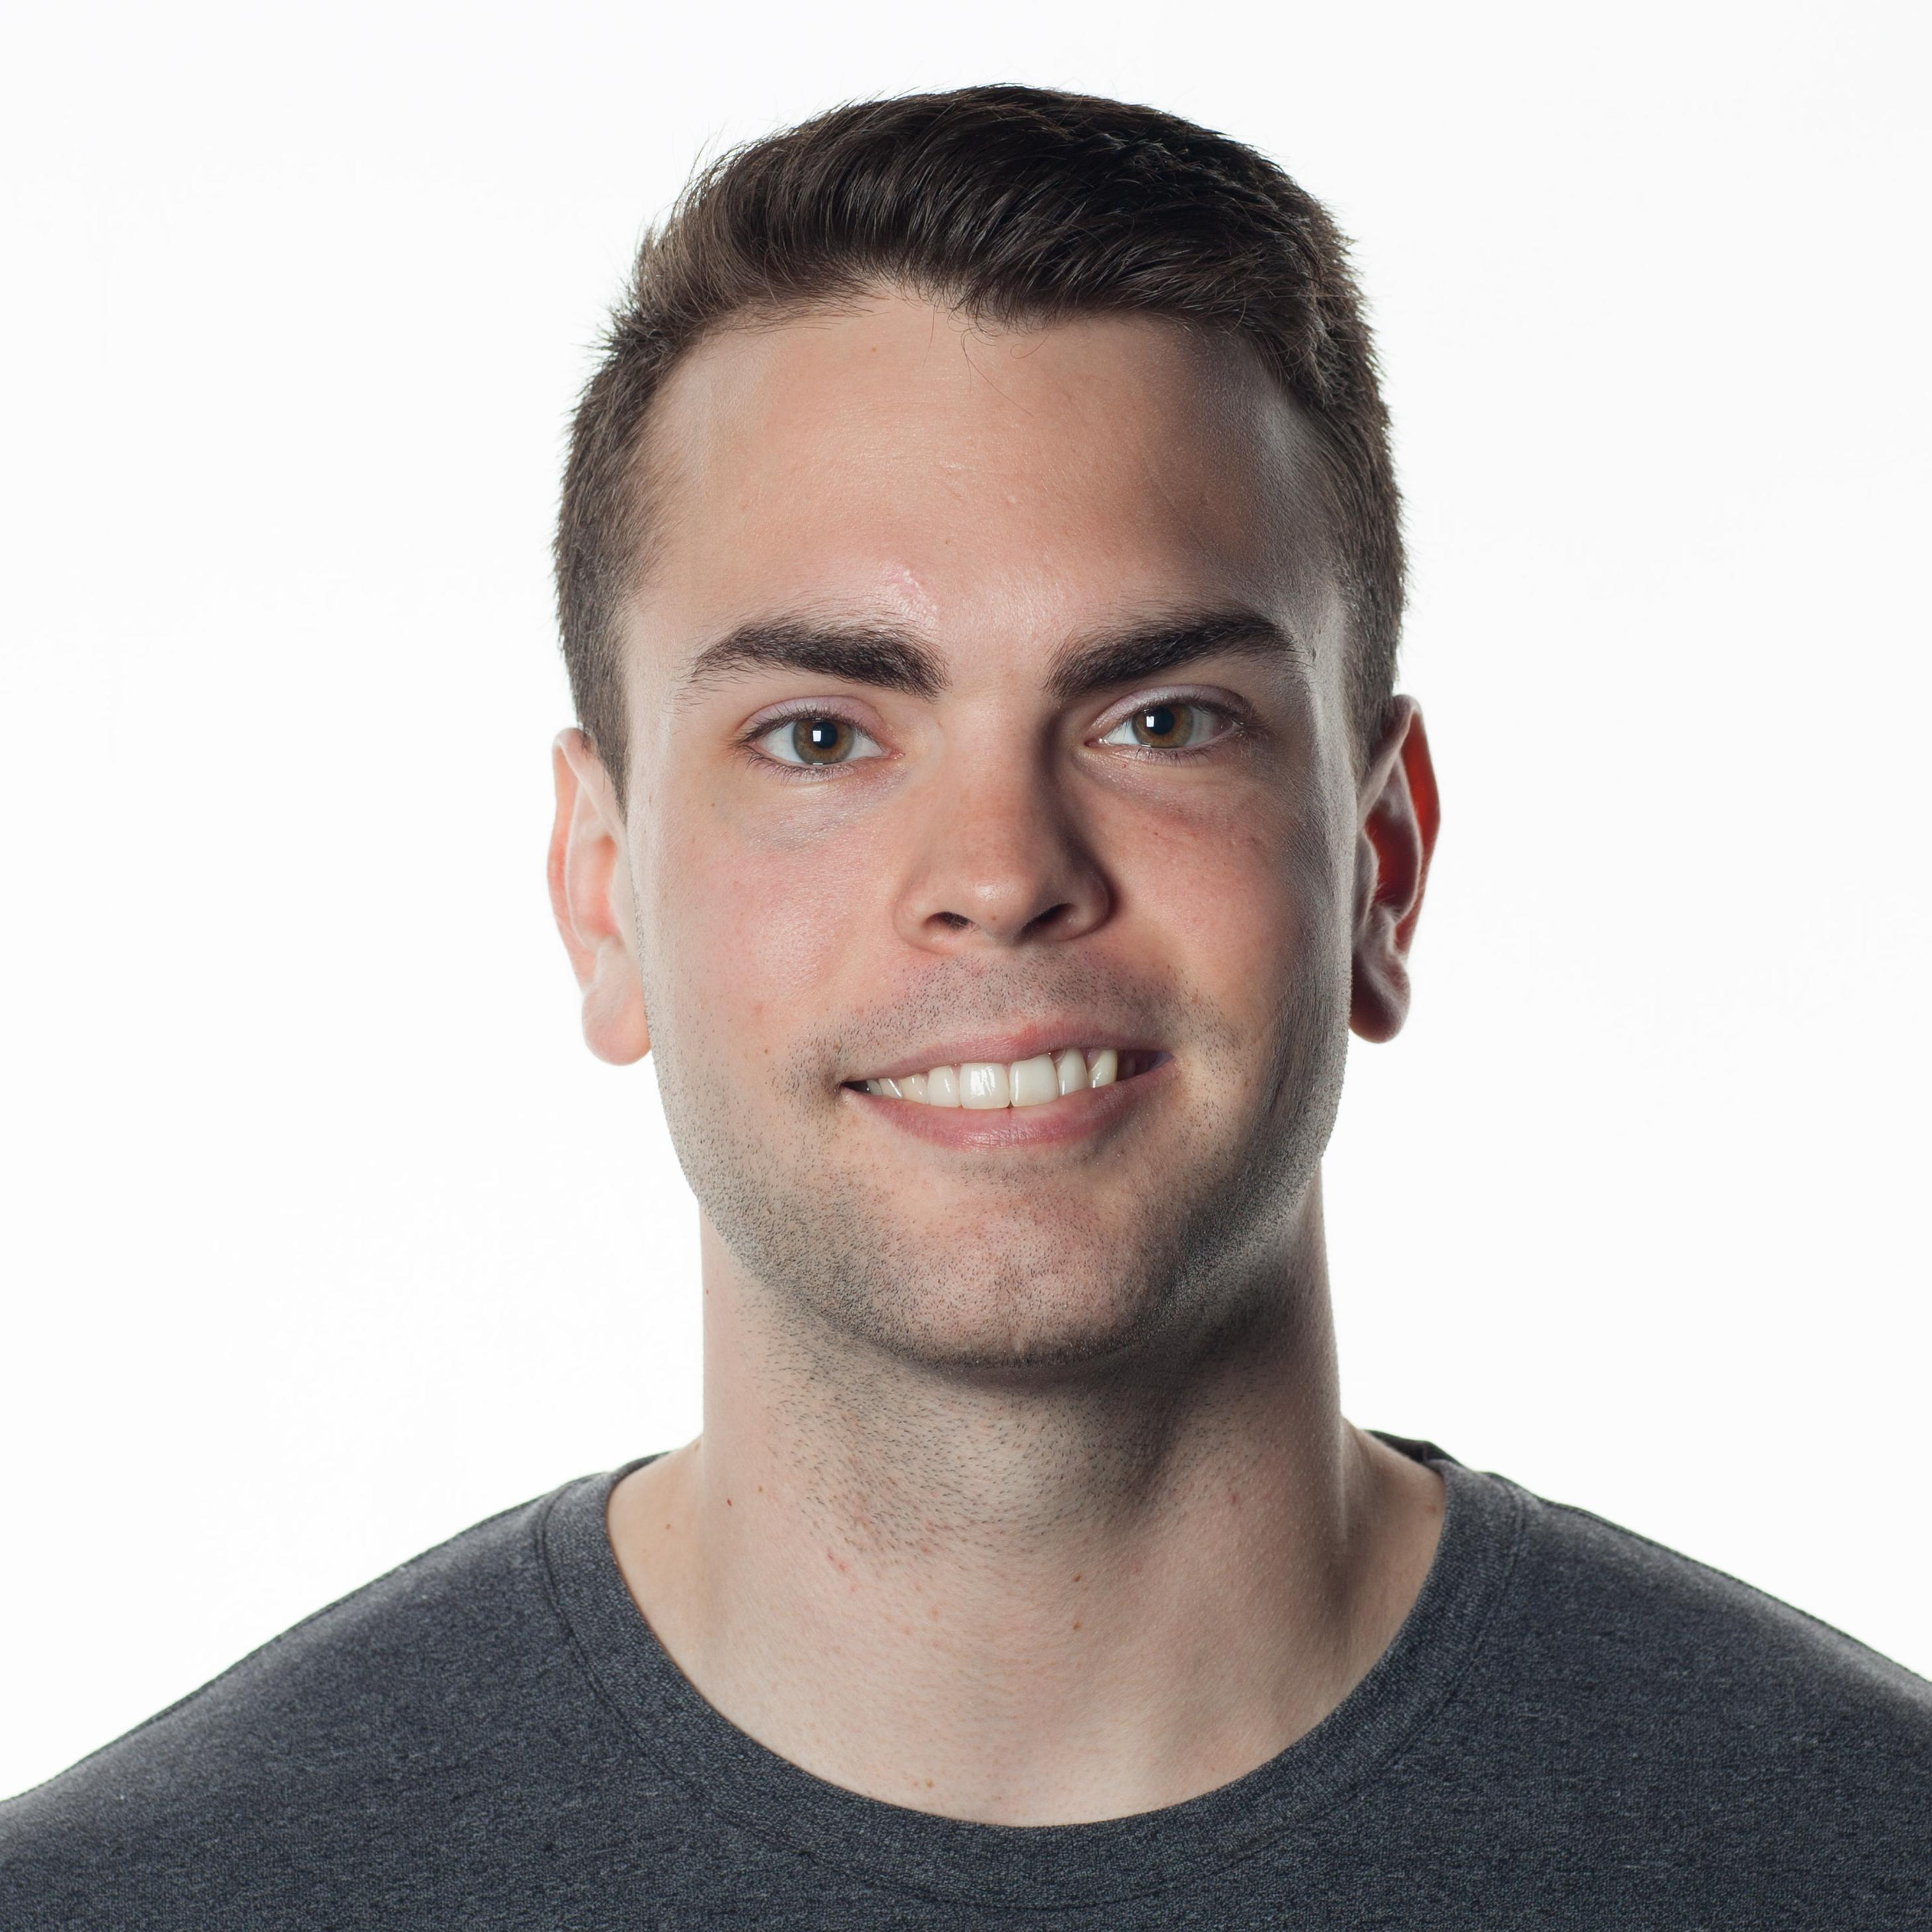
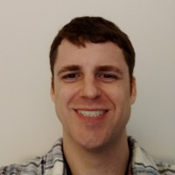
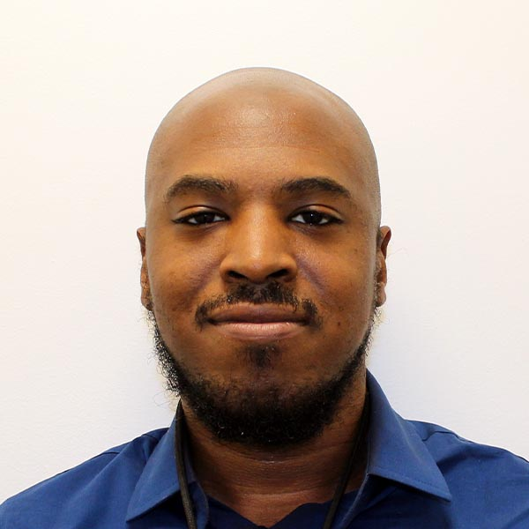
INTRODUCTIONS
Matthew Stevens AWS Cloud Engineer, Mid HEALTH ACCT
Host/Developer
Brittany Johnson AWS Cloud Engineer, Mid
AEROSPACE ACCT
Robert Clinger Cloud Engineer, Mid
NMC ACCT Developer/Admin
Zachery Sawyer AWS Cloud Engineer, Mid AEROSPACE ACCT
AWS Admin
Asbury Sellers AWS Cloud
Engineer, Mid
AEROSPACE ACCT
Notes:
First, let us go ahead and introduce the team. My name is Matthew Stevens. I am the host for today's presentation.

Slide 4

Group 1 Project
Overview
Introductions
Project Overview
Tools/Software Environment used
Architecture/Design diagram
Challenges/Issues/Problems/Your stories
What have you learned/learned?
Demo
What else can we do on the project? - future plan- any design and implementation ideas?
Questions and answers
Thanksgiving themed madlib site hosted on AWS
www.webagesolutions.com|1.877.517.6540
Notes:
For a quick overview, we'll go ahead and discuss all of the tools that we used for this project, give a high level overview with our Architectural diagram, discuss some of the challenges that we faced and some insight into how we solved those problems, discussed the various things that we learned along the way, then dive into a live demo so that you can see our application in action. We'll wrap things up by discussing the future state of the project and additional features to implement given more time, then open the floor to questions. I'll pass it over to Brittany to discuss the tools used for our project.

Slide 5
Technologies and Environment used
Tech:
Python 3.9
Boto3
MySQL-Connector
Flask
gunicorn
Github.com
Jenkins pipeline hosted on EC2
Ubuntu 20.04 and AWS Linux2 Karoo
AWS:
CLI – Command Line Interface
S3 – stored an AMI, RDS snapshots
EC2 – Instances, ELB, Security Groups, AMI backups
Certificate Manager
IAM w/ MFA
RDS MySQL DB
Secrets manager
Cloudwatch
Notes:
Brittany

Slide 6
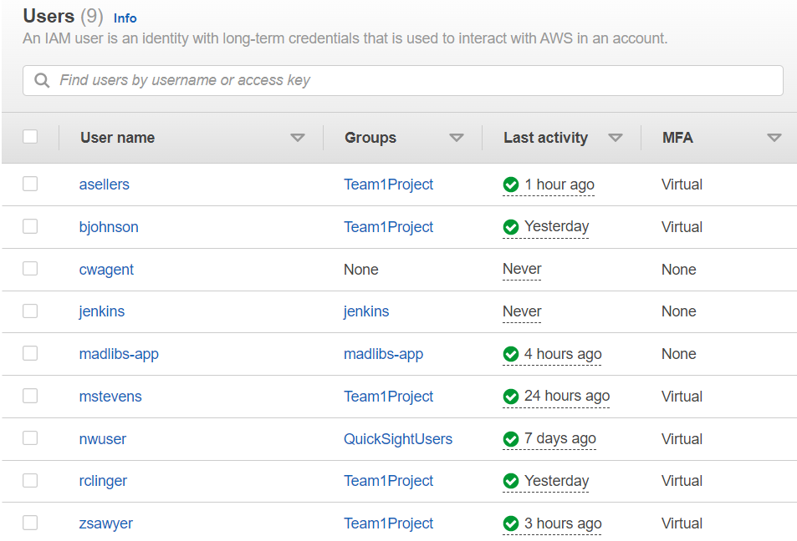
Identity and Access Management
Utilization of the IAM service to provide access to the RDS application for automated monitoring
Provided AWS environment access to team members.
MFA for added security
Notes:
Asbury
Identity and Access Management

Slide 7
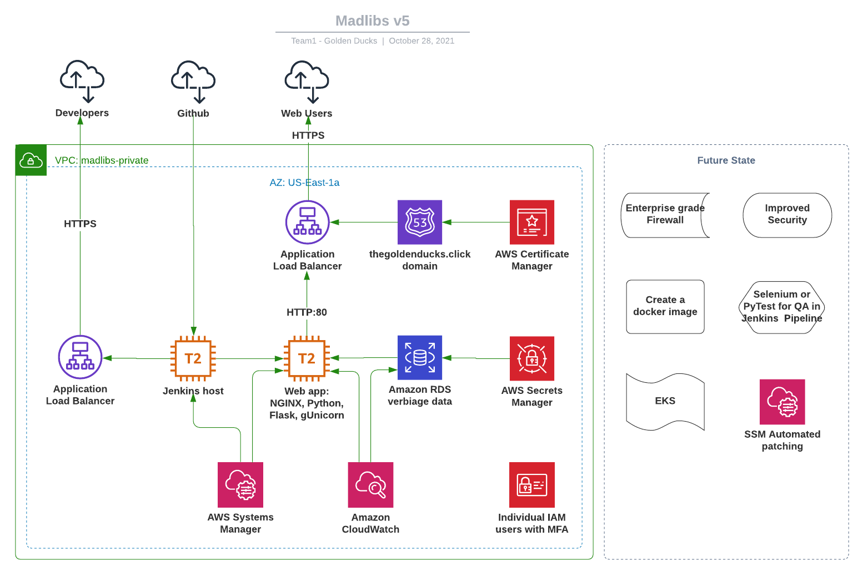
Architecture and Design - Infrastructure
Notes:
Zak
We went with a fairly traditional architecture, but it works well and serves the need of our application and developers
As we know, its is important for the infrastructure to meet the needs of the application rather than be the newest or flashiest.
We have our app hosted on an ubuntu AWS instance, as well as a Jenkins instance with Amazon Linux 2.
The app is pulling verbiage data from RDS
Security:
Systems manager instead of open ssh ports
Individual IAM accounts for each user, and everyone has MFA setup
Credentials for the DB are stored in AWS Secrets manager
We also setup an ELB.
Traditionally ELB is meant for scaling, but it also provides a bit of a security measure to keep those servers from being over exposed to the
ELB works as an HTTPS terminator, after we made a cert in AWS Cert Manager.

Slide 8
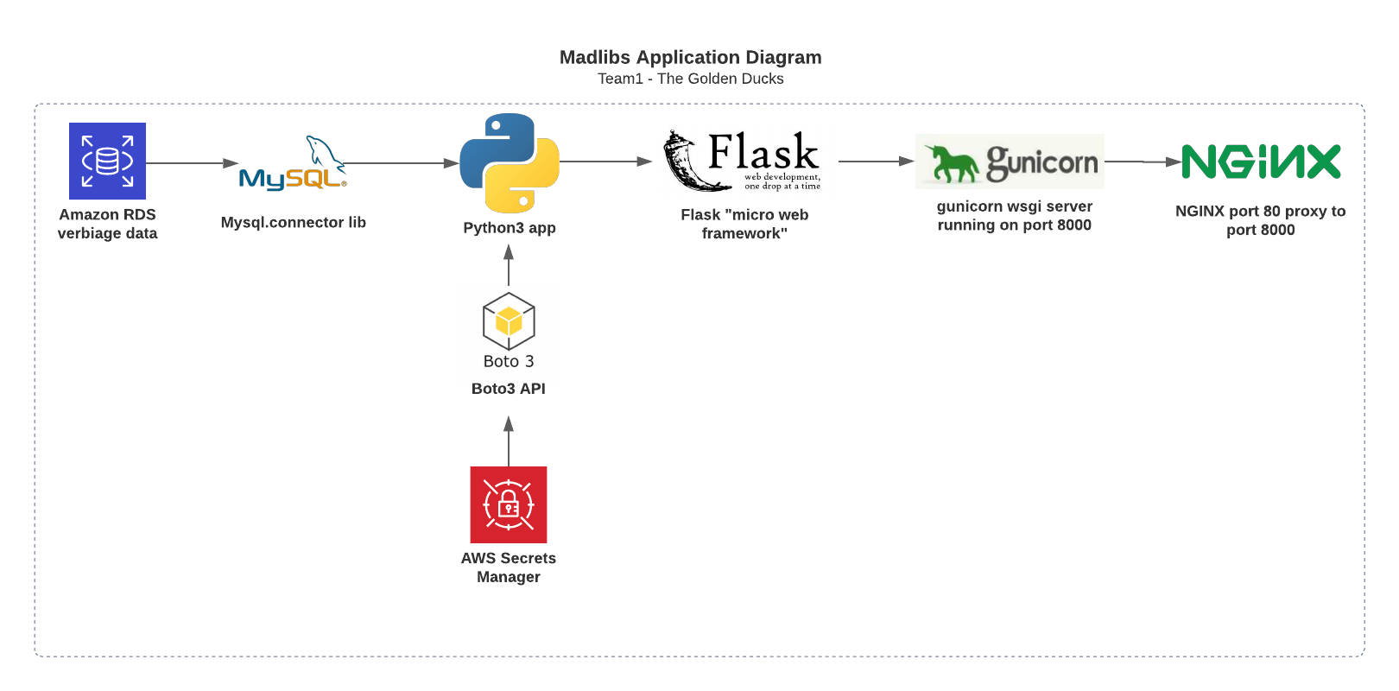
Architecture and Design - Application
Notes:
Rob
Python was chosen as the main language of our application architecture, as it was the most familiar among all of us with coding experience. Using the Flask microframework as the back end to our webpage means we needed to utilize a WSGI (short for Web Server Gateway Interface) in order to effectively serve our application on NGINX. After researching potential solutions, we settled on “gunicorn”, which allows us to establish a proxy port to NGINX and serve our flask application as a traditional web application would be served.
In order to communicate with our AWS RDS MySQL database, we decided to utilize the boto3 package provided by the AWS SDK for python to request environment variables rather than hard-coding potentially sensitive information. This allows us to retrieve stored credentials in AWS Secrets Manager as well as RDS database attributes in order to establish connection parameters and authenticate to our database instance programmatically.

Slide 9
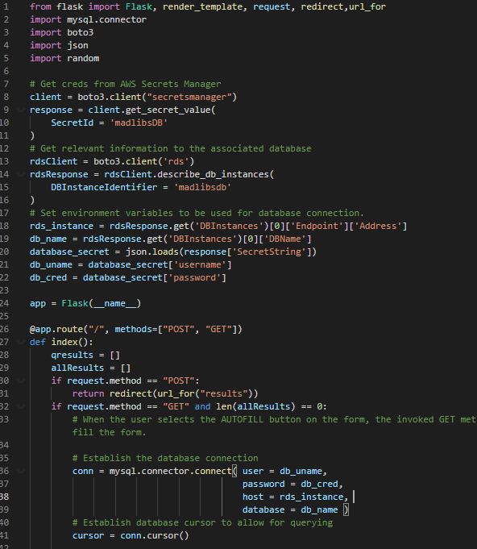
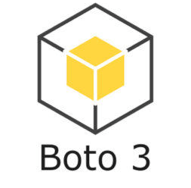
Architecture and Design – Application cont.
Defining our environment variables outside of the flask app itself allows us to utilize them globally to establish database connections and authenticate, as necessary.
Utilizing the AWS SDK for Python (boto3) allows us to accomplish this programmatically without hardcoding sensitive resource information.
Notes:
Rob

Slide 10
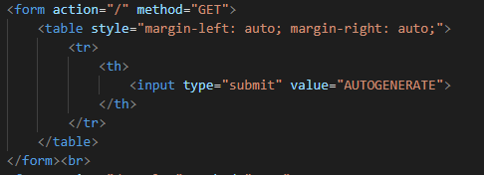
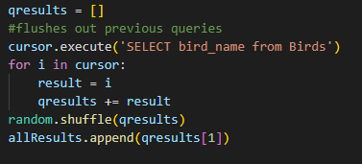
Challenges and Issues - Flask and MySQL
Implementing a RAND() method to the MySQL query maxed out the CPU usage on the MySQL database, so we implemented the method in python on the array which removes taxing any AWS resources
Flask does not utilize onClick events for buttons which posed a problem with triggering pulling information from the database. Since Flask uses HTTP methods, the database is called whenever retrieving information, including when the user first opens the application.
Notes:
Next, we'll discuss some of the challenges that we faced during this project and how we overcame them.
For the flask application, we ran into challenges triggering the database retrieval due to Flask only using HTTP methods as triggers as opposed to onClick events like a standard Javascript implementation.
For MySQL, we realized that including the Random method in the query was overloading the resources for the MySQL database and we pulled the information to an array and handled it with python to stop taxing the RDS resources.
I will pass it over to Brittany to discuss her challenges with Cloudwatch.

Slide 11
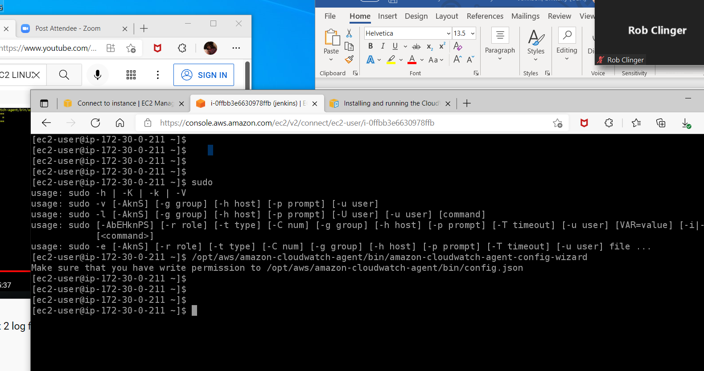
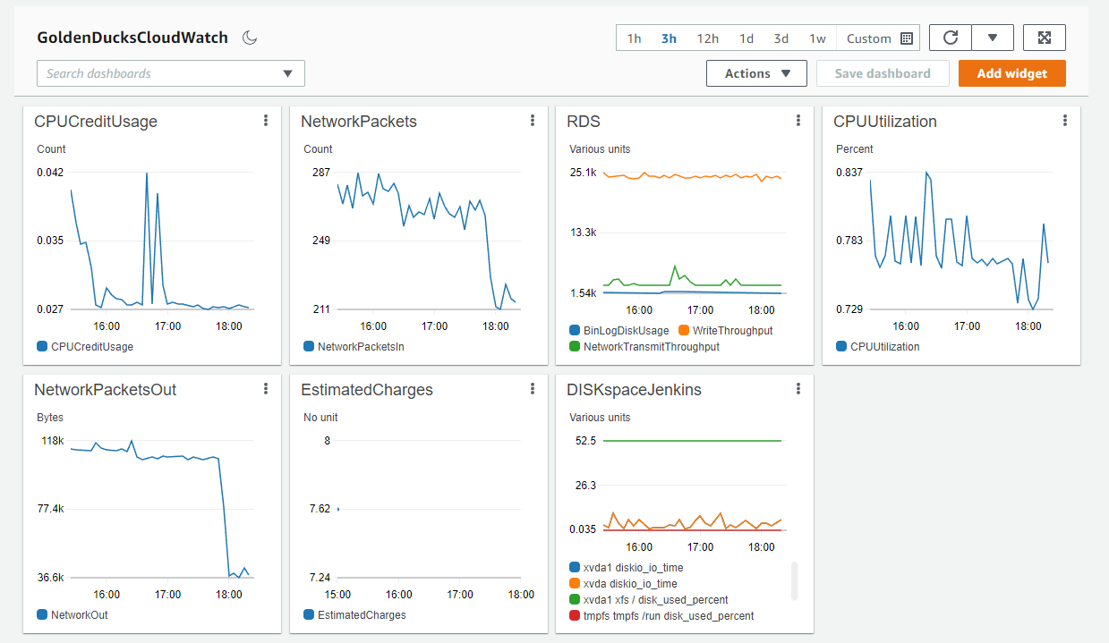
Challenges and Issues – Cloudwatch
Notes:
Brittany

Slide 12



Challenges and Issues - Monday
Stopped the instances on Saturday afternoon.
Started instances on Monday morning
App won’t start
Notes:
Zak –
Five alarm production incident.
I stopped the instances over the weekend. I came in on Monday, turned everything back on and it was a five alarm fire. The app wouldn’t work.
We had to install a bunch of libraries to get the application to run.
We were just trying to figure out why that happened and nothing ran. Eventually we figured out we had done a lot of code updates on Friday but never restarted the application. To fix the issue, I made the application run as a service and added a step in Jenkins to restart the app after every build.

Slide 13

Challenges and Issues – CI/CD Tools
First time using CI/CD tools outside of the lab.
Codecommit difficult to setup vs Jenkins
Jenkins pipelines very straightforward and well documented.
Tried to make a Python QA script.
Had trouble with Selenium web drivers.
Selenium Chromium didn’t run well in headless mode.
T2 micro not enough ram to run Chromium.
Switch to a simple bash script.
Learned a lot about CI/CD tools
Jenkins is a great tool for infrastructure as code.
DSL well documented, easy to use.
Notes:
Zak
My first time using CI CD tools
This slide is pulled

Slide 14

What Have We Learned?
Web Development with Flask
Implementing a MySQL database with AWS RDS.
Using Git and GitHub for collaborative development and SCM.
Utilizing the AWS SDK for Python (boto3) to interact with AWS Resources.
Connecting various AWS Services together.
Continuous Integration/Deployment with Jenkins pipelines.
How to turn a simple Python application into an interactive website.
Resource Monitoring within AWS.
Mindfulness of cost management while operating in an AWS environment.
Notes:
This project was my first time using Flask and was a great learning experience for python development. Additionally, we were all able to utilize a large variety of AWS services for this project and come away with a deeper understanding. I have previous experience with creating domains and certificates so it's been insightful to learn how to do this process in an AWS environment.
Next, we'll begin the live demo of the application.

Slide 15
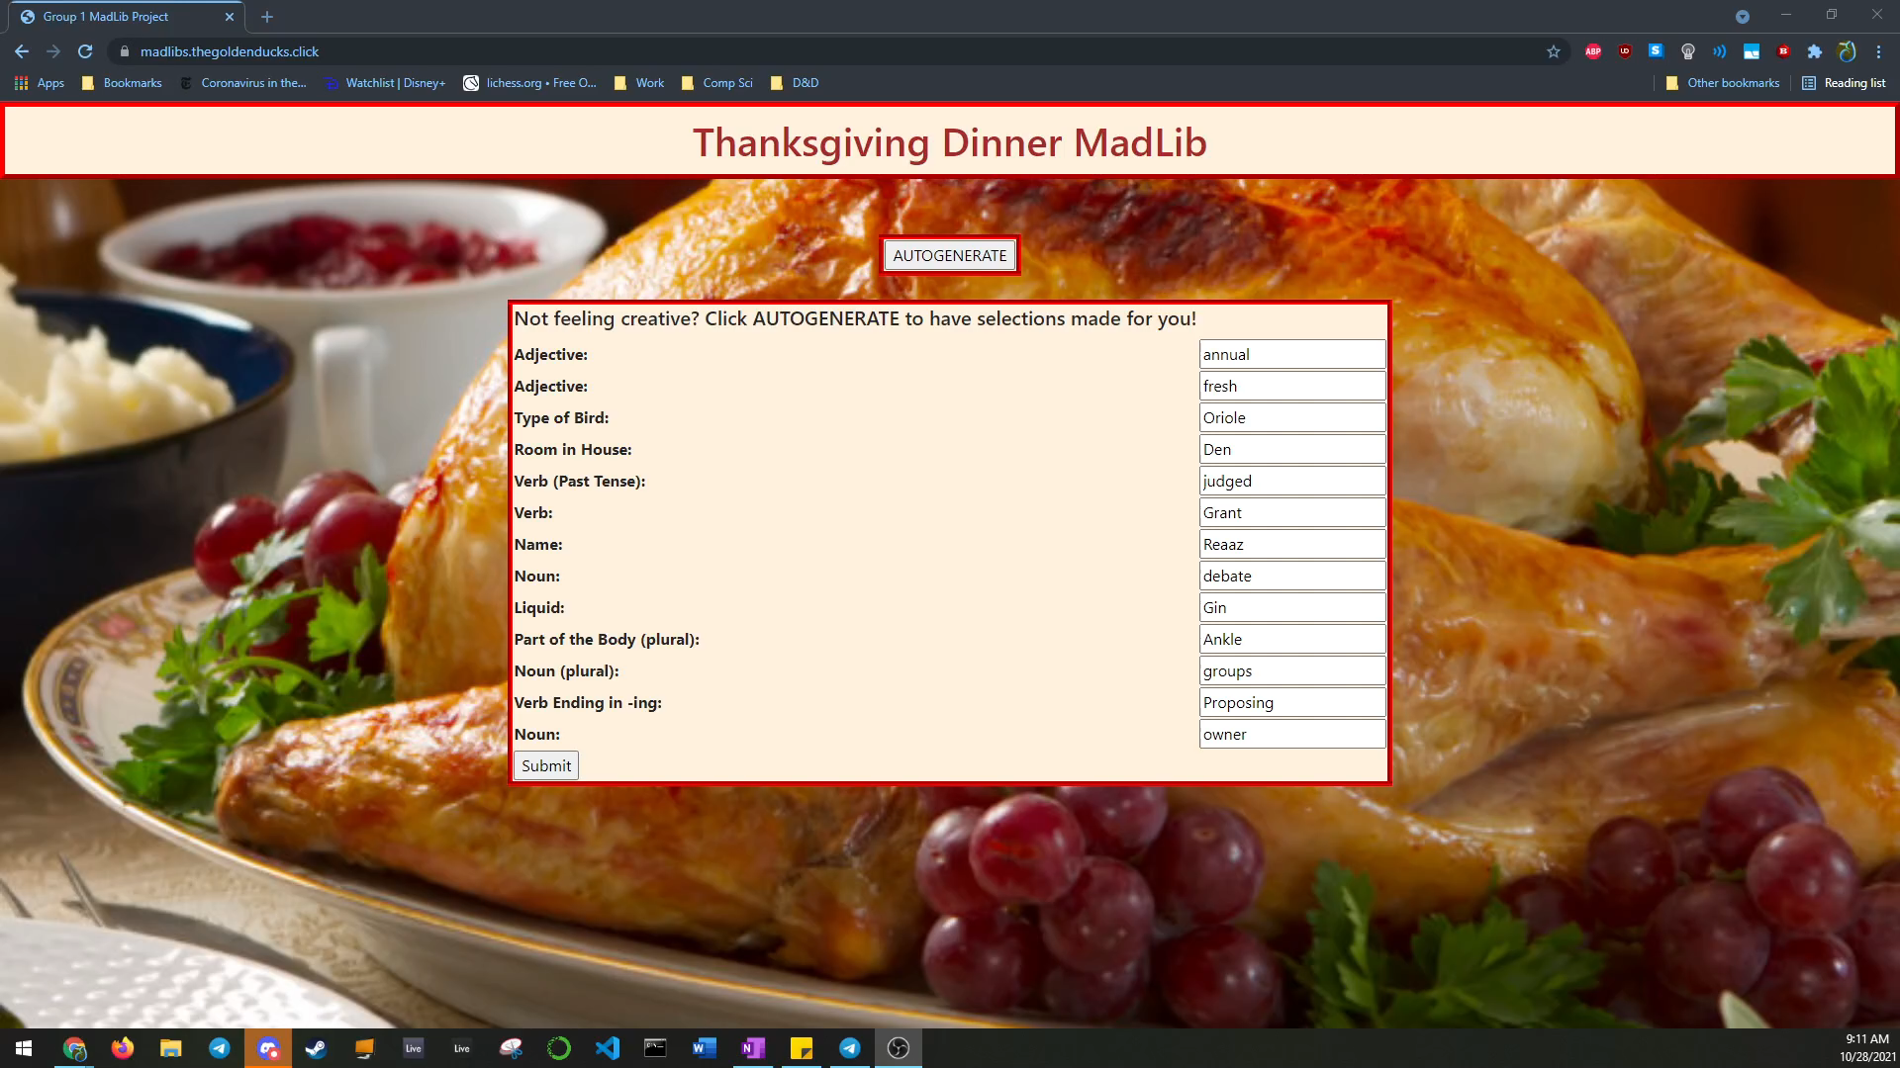
Demo - App

Slide 16
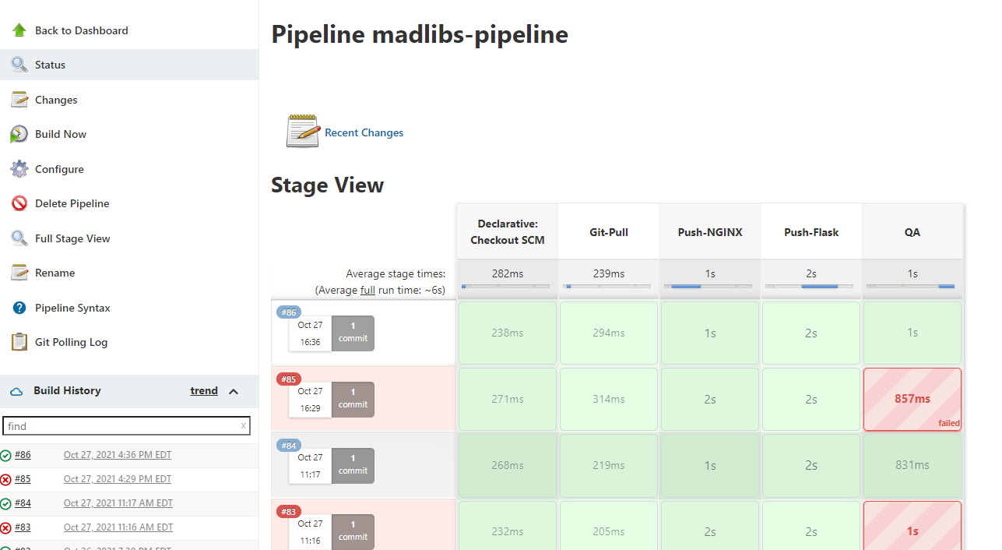
Demo - Jenkins
Notes:
Zak
Jenkins Pipeline
Jenkinsfile pulled from git
Stages
Different stages – needs a dev and QA environment to push code through all stages with proper testing

Slide 17
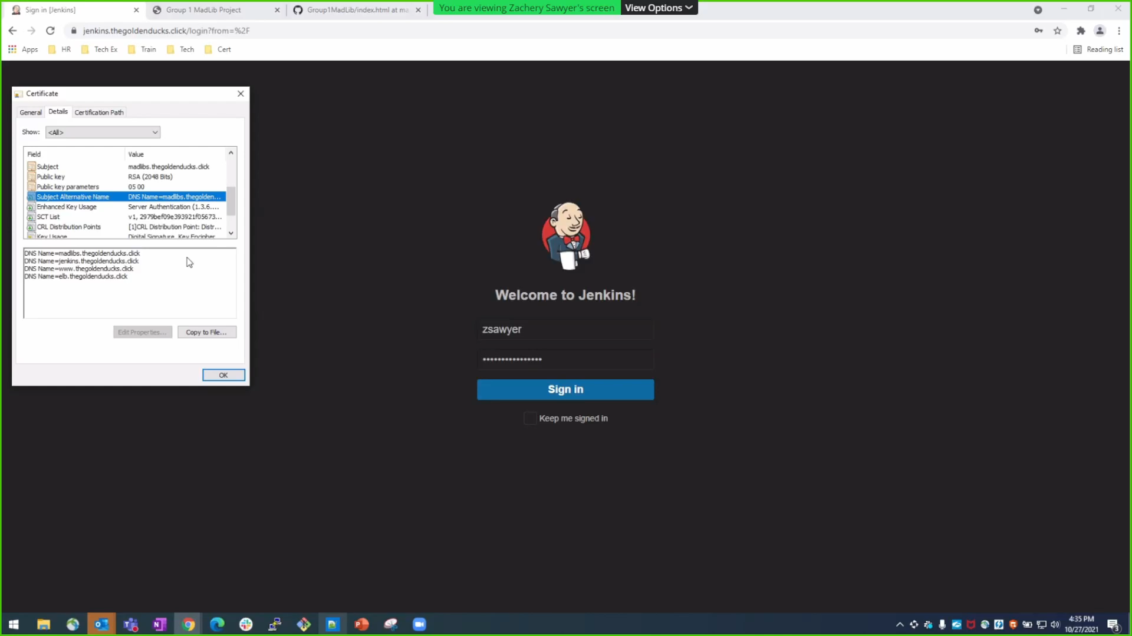
Demo - Jenkins
DEMO GOES HERE!
Notes:
Zak
USE MUTE
domain – Jenkins.goldenducks.click
https with a cert going to an ELB
Jenkins Pipeline
Jenkinsfile pulled from git
Lots of builds
Now do a demonstration
Test QA Script
Remove the s from thanksgiving
Build – show failure on the QA step
Show the website with the missing s
Fix git, push changes and show the website again.

Slide 18
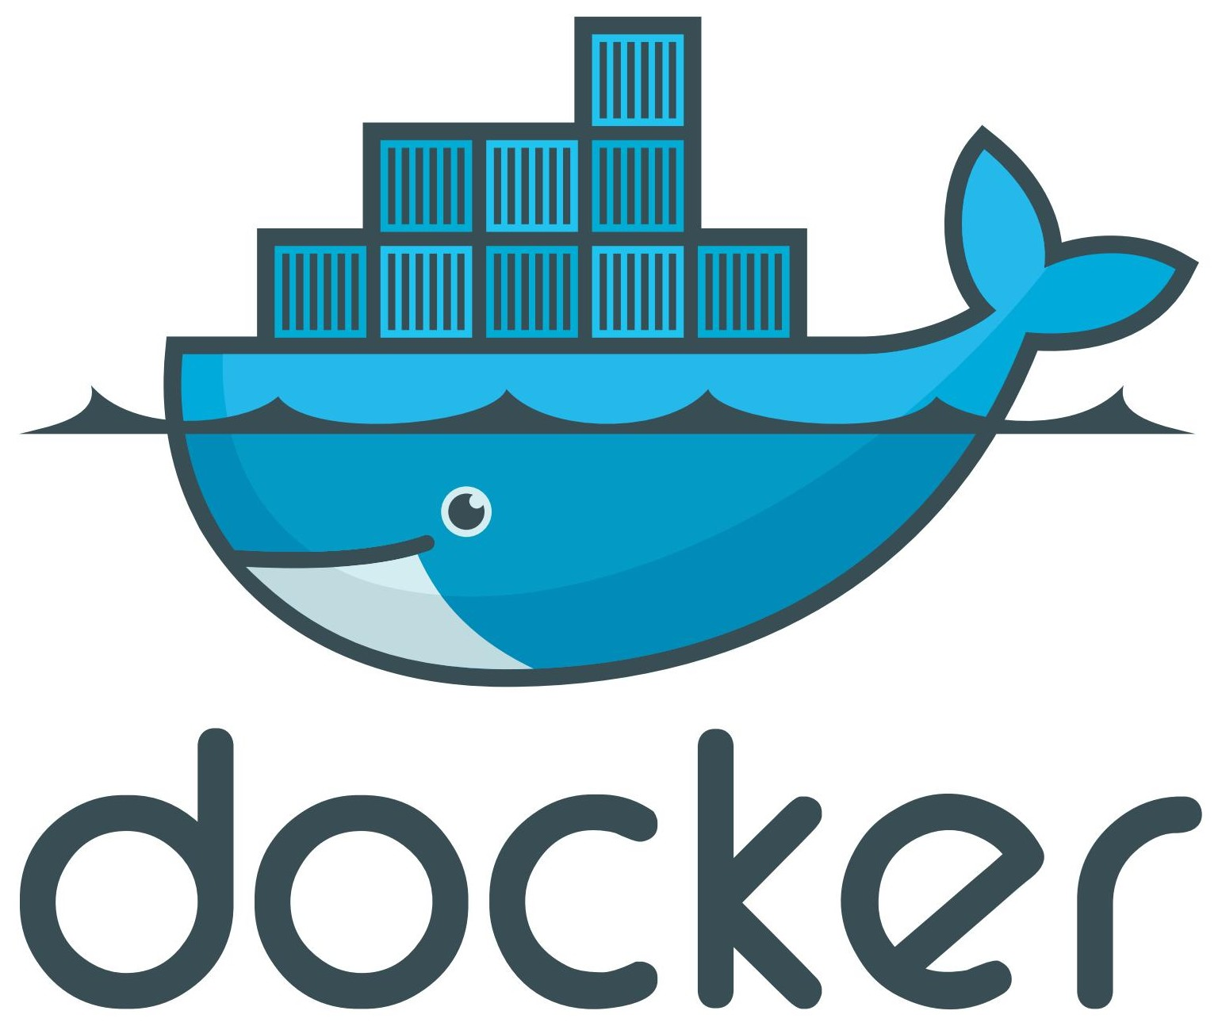
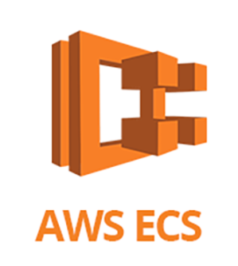
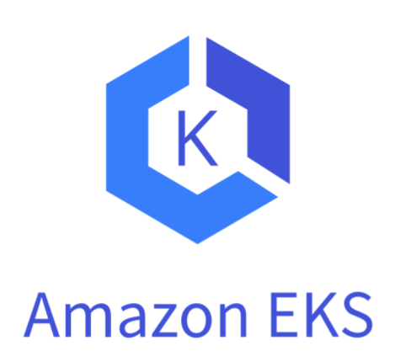
Future State - What we would add
Dockerize the Madlibs application for portability and experiment with AWS ECS or EKS for scalability and more efficient deployment.
Expand Jenkins testing stages to include input verification.
Continue to develop the application so that input fields are not automatically filled when the user initially loads the webpage and continue to build the user experience.
Normalize RDS database and optimize the queries made from the web application.
Notes:
Rob

Slide 19
Q & A - Ask us anything
Notes:
Thank you everyone for watching our presentation.
we learned a lot, and we really enjoyed the project.
We will open up the floor to any questions.

Slide 20
Thank you!!!
MARCH 2021

Slide 21


Challenges and Issues – Dev Access
How to both secure the environment and give the developers access?
SQL server shouldn’t be public.
Devs need access to MySQL server to test code on local machine.
Devs cannot push code everytime they need to test a code deployment, would result in 1000 code changes.
How to give the Devs access without exposing server to internet?
Need a VPN/Direct connect for dev access to MySQL for dev.
This is an example of challenges to meet the needs of devs while also providing a securing the environment.
Notes:
Zak

Slide 22
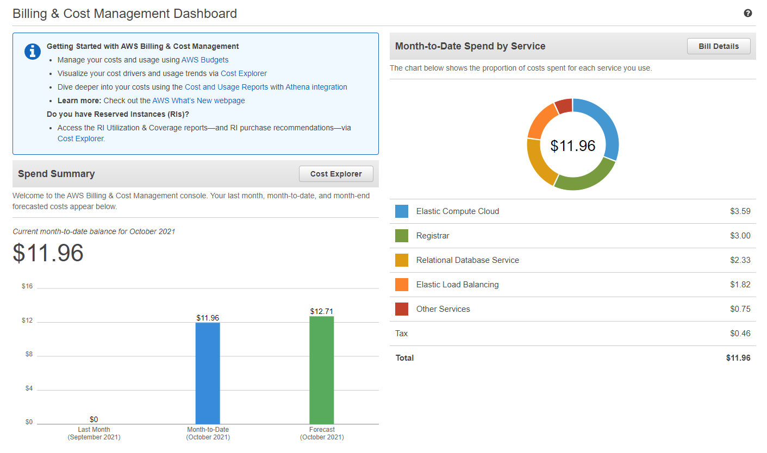
Challenges and Issues – Cost Management
Cost Management
Attempted to stay in free tier
It lacked the features we needed for Python + Flask.
We wanted to do a few more things.
Add HTTPS, Cloudwatch alerts, selenium.
Notes:
Zak

Slide 23
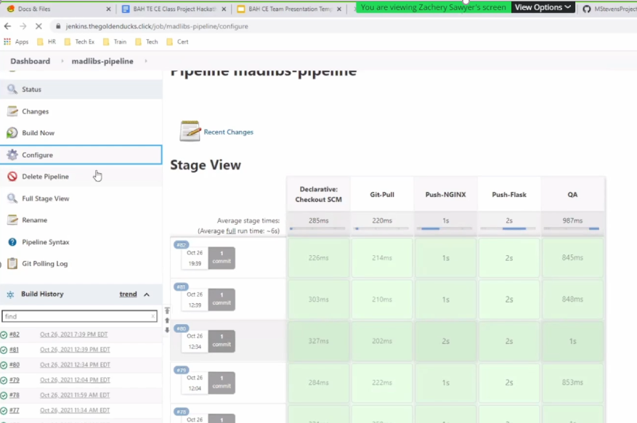
Demo - Jenkins
Jenkins.thegoldenducks.click

Slide 24

Future State – Security Improvements
Server hardening
IAM roles tightened
SG hardened
ELB whitelisted
VPN for developer access
Jumphost for IT access
Enterprise Firewall between web server and ELB
Private and public LBs
Single Sign on and AAA for all techs
SSM patching automation.
Notes:
Zak

